Slide 1

REAL ESTATE
MARKET ANALYTICS
Ramon Gomez
Michael Webb
Kathy Castillo
Arielle Williams
Jonathan Diaz

Slide 2
TABLE OF CONTENTS
01
02
03
Introduction
Data Cleaning
Methodology
Research Questions
Problem Statement
04
05
Data Visualizations
Relevance
Conclusion

Slide 3

01
Introduction

Slide 4
Introduction
The median home price in Los Angeles County was reported to be $839,780 as of August 2023,
The high cost of real estate combined with low inventory has created a problem for potential homebuyers in LA County.
The rising cost of home prices has shifted LA county’s demographics
In this project we will analyze home prices, income and demographic information within LA county to better understand how these have changed over time. We will use this information to identify the most affordable areas of LA.

Slide 5

Research Questions and Problem Statement
02

Slide 6
Research Questions
How have housing prices in LA County changed over the past decade?
How has the average income of LA County residents changed over the last decade?
How do average income and average home prices in LA County compare?
How have the demographics of LA County changed over time?

Slide 7
Problem Statement
Problem Statement:
The rising unaffordability of housing in LA County poses a pressing challenge, prompting the need to investigate and analyze housing affordability trends over the past decade using descriptive analytics.
Objective:
Investigate and analyze housing affordability trends in the years 2010, 2023 and projected year 2028.
Goal:
Our project goal is to provide a comprehensive understanding of the evolving housing affordability in LA County.
This insight will empower potential homebuyers, along with other stakeholders such as investors, businesses, advocacy groups, and policymakers, to make informed decisions and develop effective strategies in response to the challenges posed by the escalating unaffordability of housing.

Slide 8

03
Data Cleaning & Methodology

Slide 9
Data Issues
We are looking for trends, and general understanding of the real estate market so messy data is ok! We just need to take care to apply correct measurements to each hierarchy of county, city, zip.
ZIP Codes are based on postal routes not boundaries
City Boundaries change over time
2010 data set does not have all the same columns as 2023 or 2028
Getting city level data meant averaging median values for zip code level data
Filtering historical city data using current city data meant zip codes that changed would be null, get filtered incorrectly, etc…
Zillow data is smoothed and does not match 1:1 to ESRI data for average home values
We used Zillow city level to filter all visualizations.

Slide 10
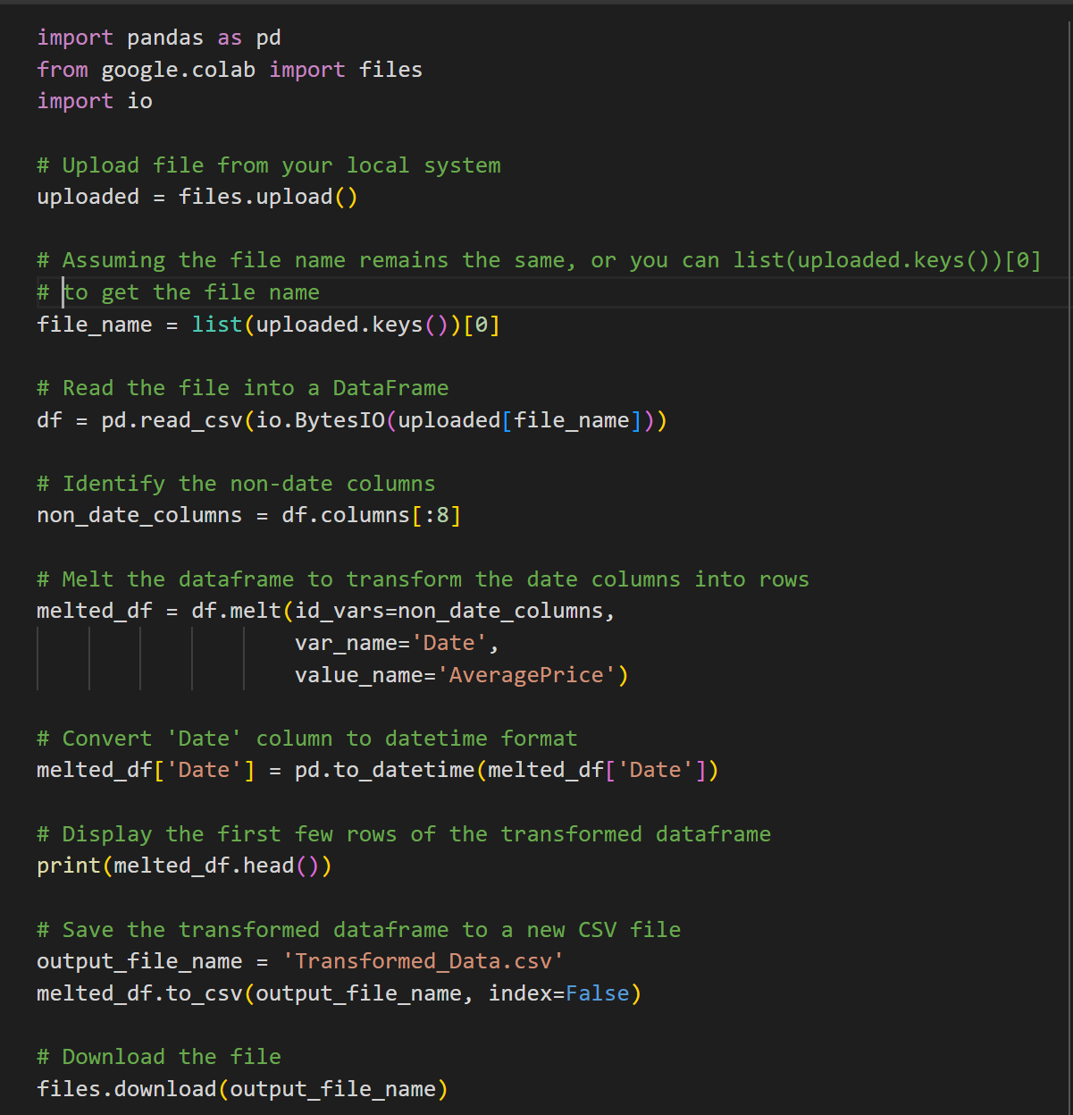
Data Cleaning
ArcGIS Business Analyst
Tables were exported in batches of columns for each year
Not all 2023 columns matched 2010 data
Most complete data was 2023
Data from 2028 was forecasted data from ESRI and used for some data exploration
For each distinct year, tables were joined together by year and zip code
Zillow Housing Data
Smoothed average over 23 year period at the ZIP code level
Zillow Home Value Index (ZHVI): A measure of the typical home value and market changes across a given region and housing type. It reflects the typical value for homes in the 35th to 65th percentile range.
Data export is in in pivot format and needed transformation
Python was used to melt the data into time series data
Filtered for Los Angeles County

Slide 11
Data Shaping
Zillow
LA County smoothed home value time series
ArcGIS Business Analyst
2010
2023
2028
Zip/City……………..…………..…..……………………………………
Avg $ ……………..…………..…..………………………………………
Year… 2000 …………..… 2010………..… 2020………..… 2023
Income
Demographics
Housing
Population
Affordability/Diversity Index

Slide 12
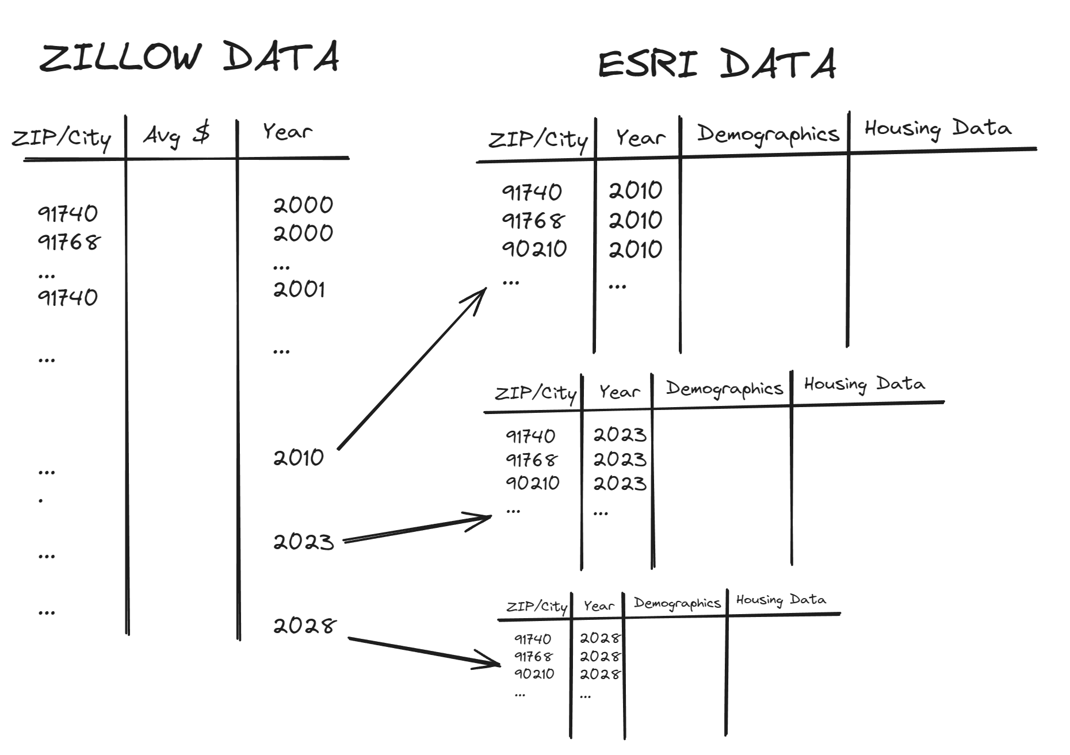
Tableau Data Model

Slide 13
Types of Analysis
Visualizations
Bar charts
Clustering analysis
Time Series Line charts
Pivot Tables
Bubble chart
ArcGIS
Heatmaps
Filtering

Slide 14

04
Data Visualizations

Slide 15
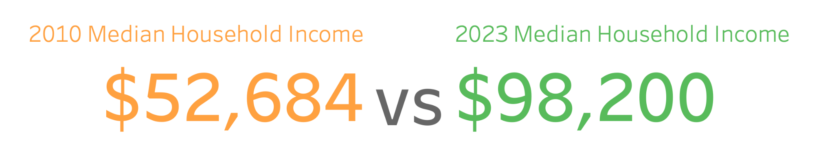
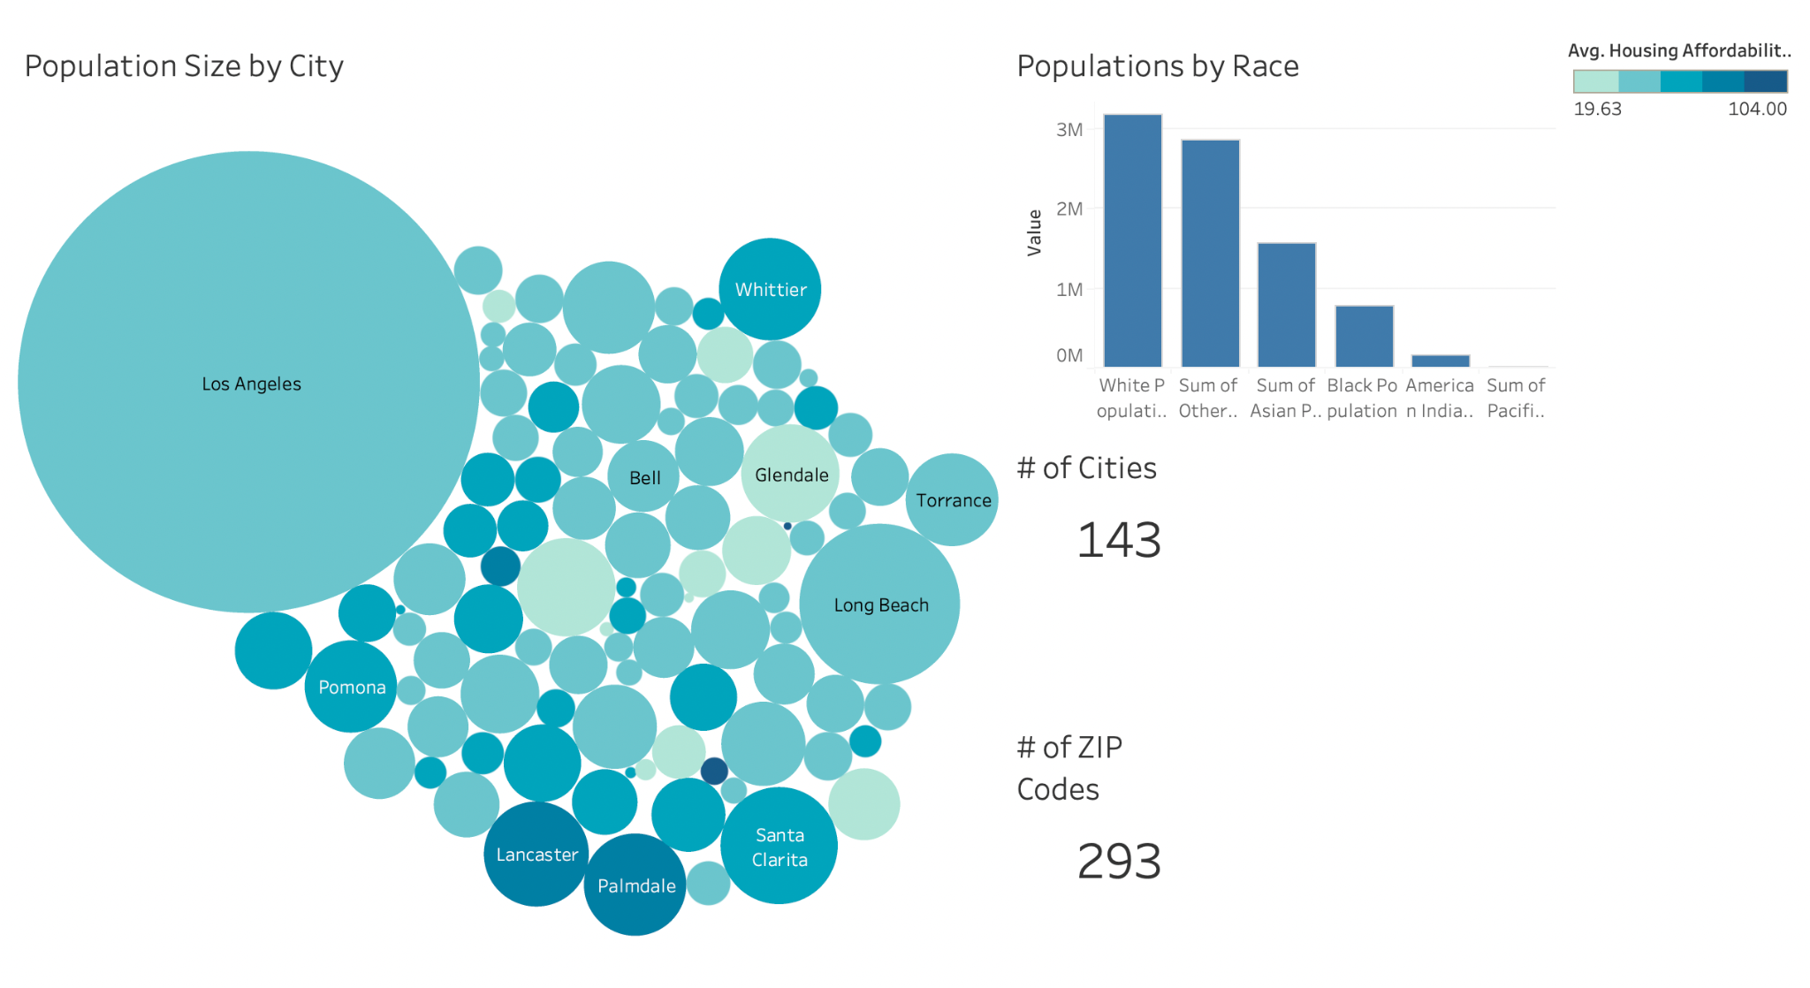
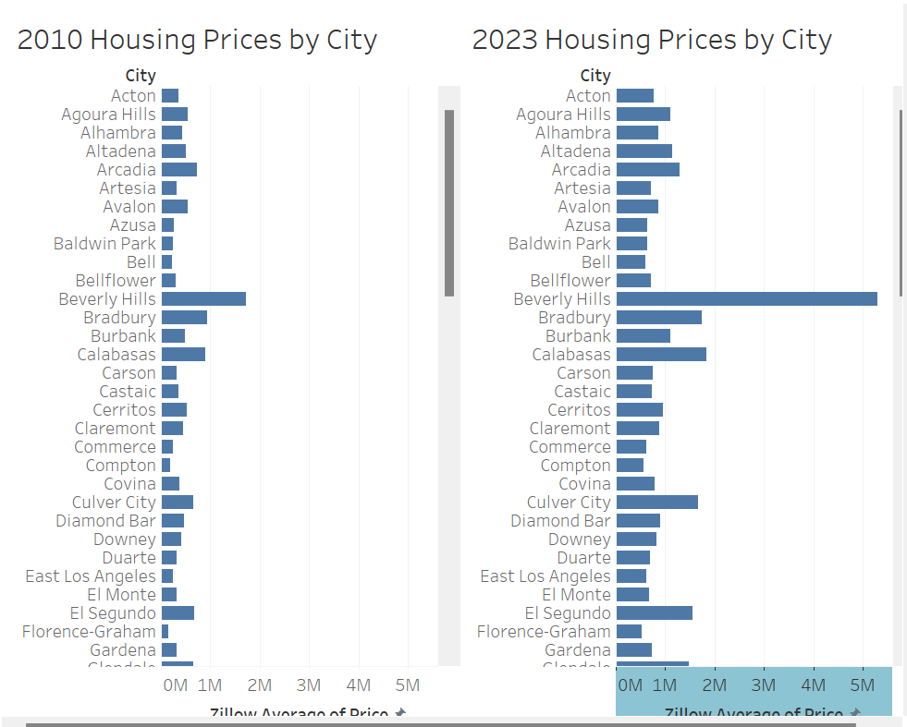
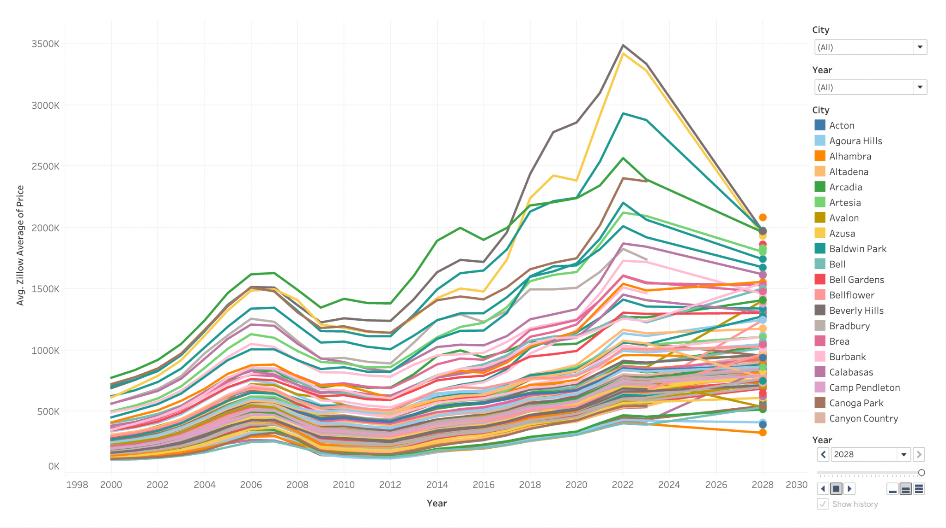
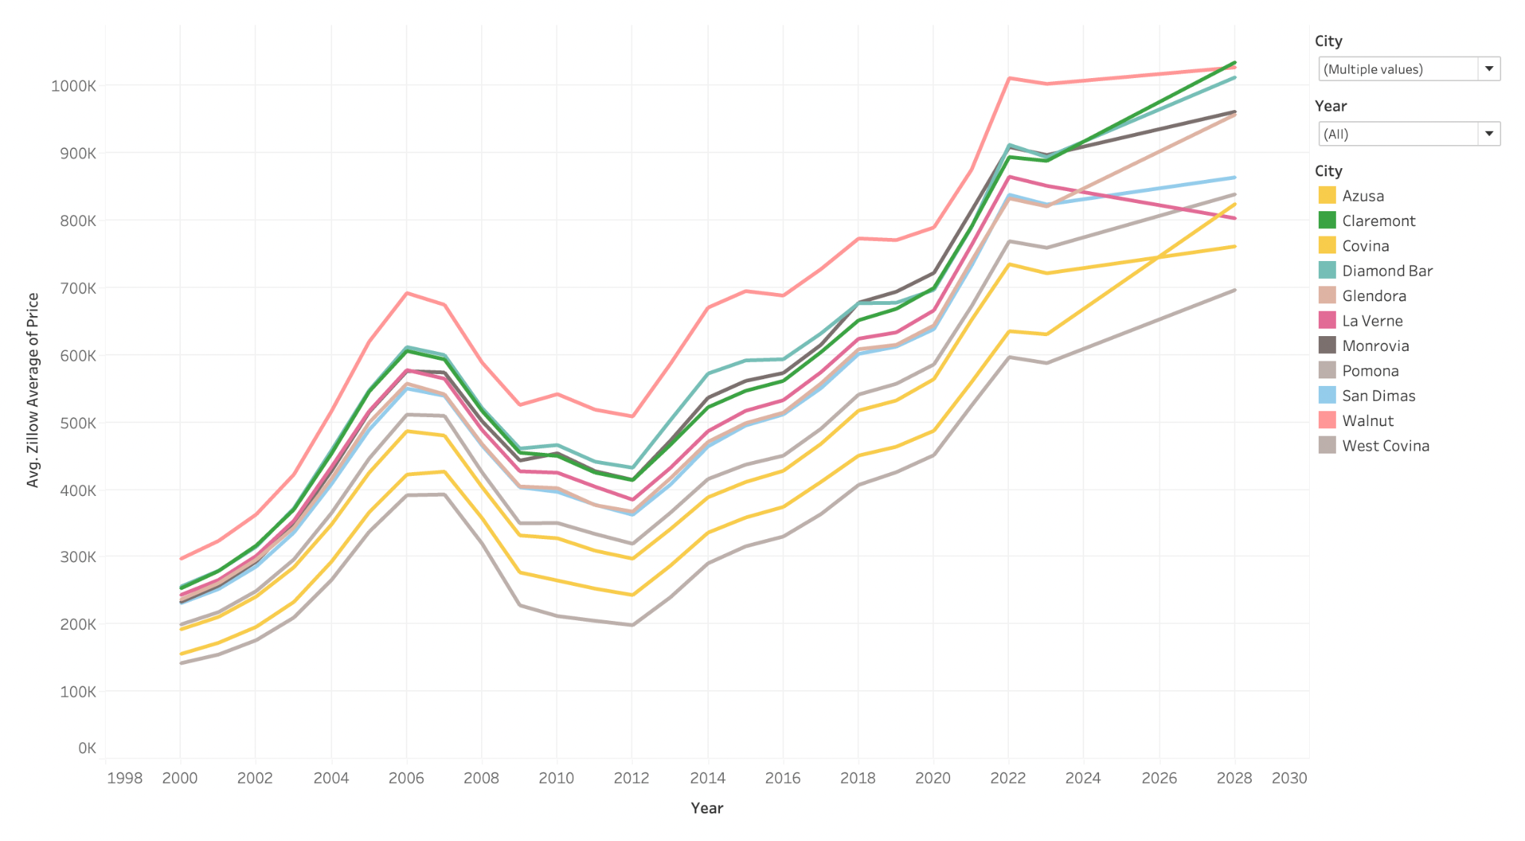
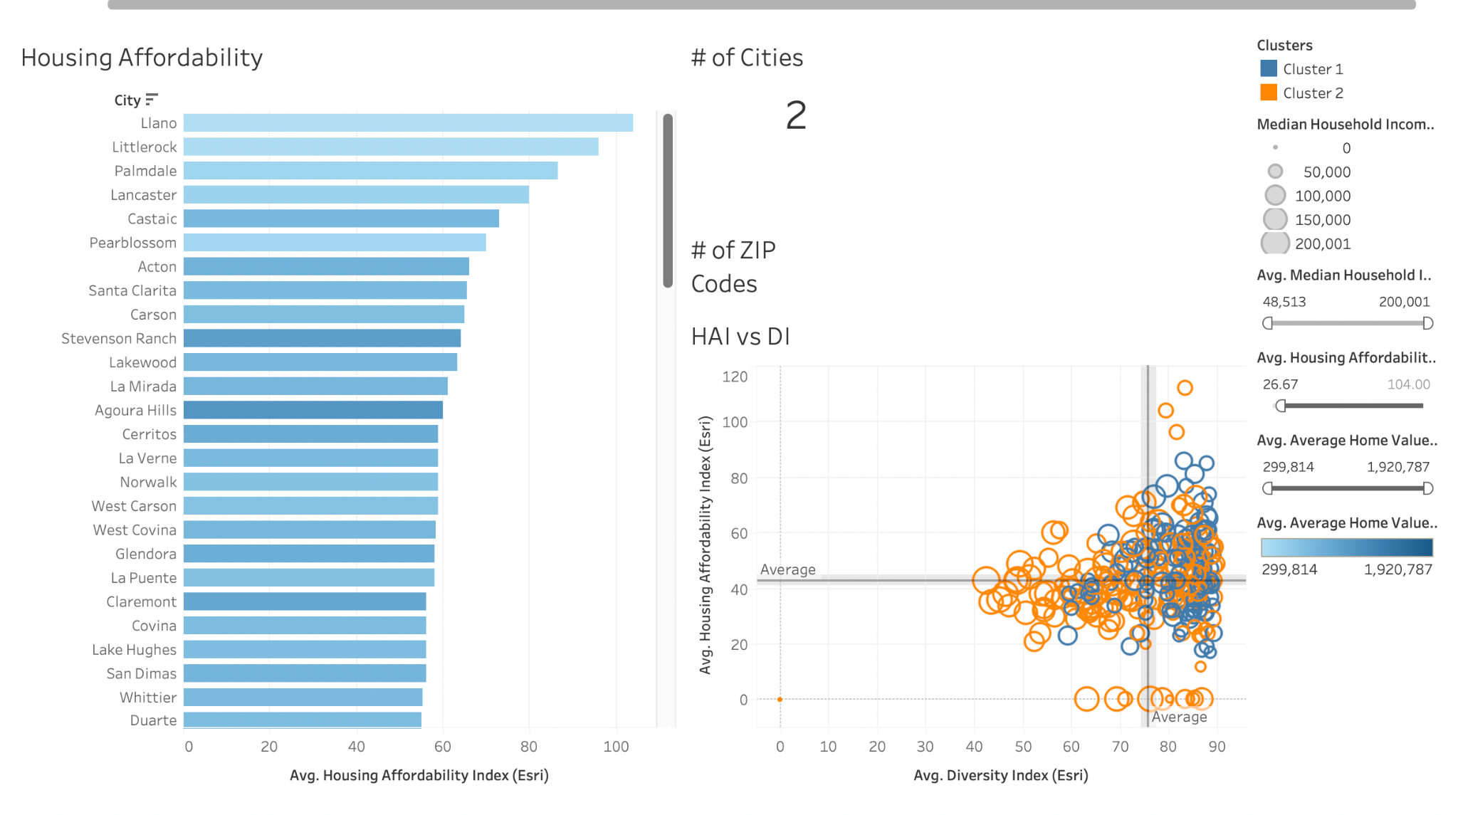
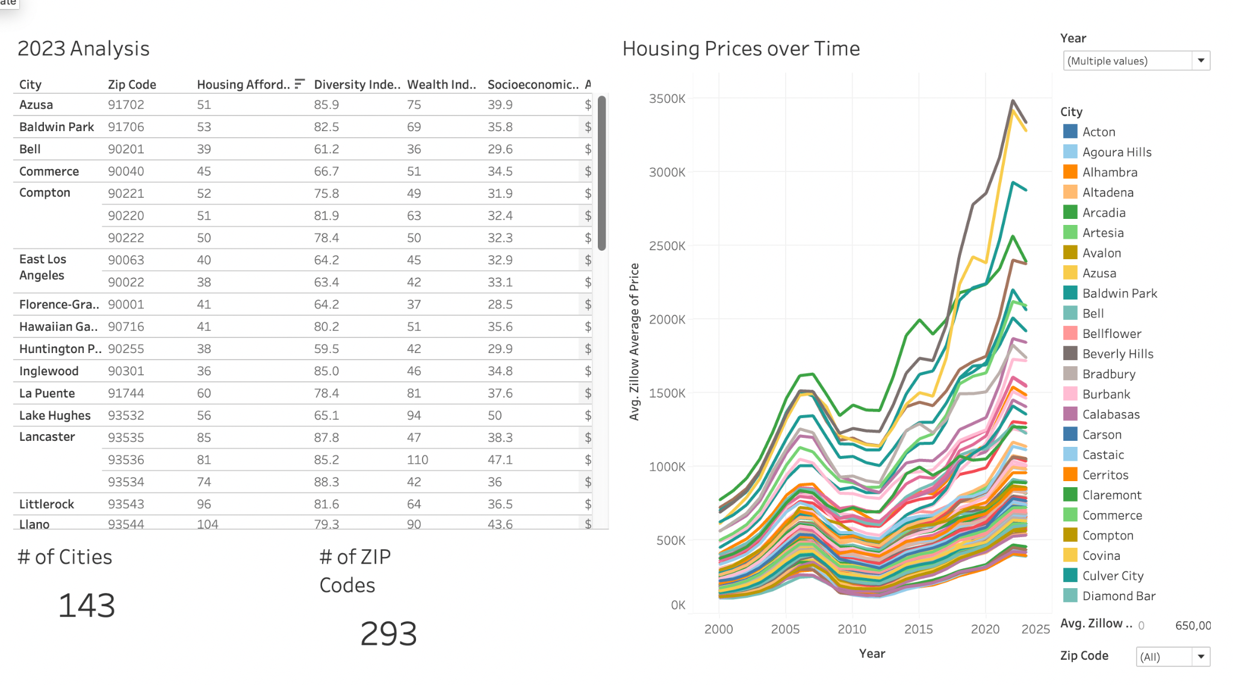
Data Visualizations (1)
Tableau:

Slide 16
Data Visualizations (2)
ARCGIS: https://experience.arcgis.com/experience/fe03f292825c4caa90daffbb6764a0cc/

Slide 17
05
Relevance
Conclusion

Slide 18
Relevance
Why Address the Housing Crisis in LA County ?
Affordability and Cost of Living:
Prices of houses have continued to skyrocket over the years
Decline in number of individuals who can purchase homes
Homelessness:
Housing crisis in LA County is closely linked to homelessness
Sine 2020 there has been an increase in homelessness
Economic Impact:
Decrease in job opportunities in the area
Affect local businesses, both consumers and workers

Slide 19
Who Should be Concerned?
Residents: unaffordable housing can directly impact quality of life
Policymakers & government officials: in order to allocate funding & initiatives for these issues government officials need to be aware
Advocacy groups: play a crucial role in advocating for policy changes, helps raise awareness about housing issue in LA County
Business & Employers: If housing prices maintain high it becomes difficult to retain employees which is not good for businesses

Slide 20
Conclusion & Recommendations
Utilized BI tools (ArcGIS, Tableau) for insightful analysis on housing affordability in LA County.
Addressed research questions:
· How have housing prices changed in LA County over the past decade?
· How has the average income of LA County residents changed over the last decade?
· How do average income and home prices in LA County compare?
· How have the demographics of LA County changed over time?
Recommendations: Further research could be explored on specific factors influencing trends.
Provided target audience with comprehensive insights into the changing landscape of housing affordability in Los Angeles County.

Slide 21
References
Agarwal, S., Deng, Y., He, J., Wang, Y., & Zhang, Q. (2023). Lenders’ pricing strategy: Do neighborhood risks matter? Real Estate Economics, 51(4), 1011–1047. https://doi-org.proxy.library.cpp.edu/10.1111/1540-6229.12421
Blumenberg, E., & Siddiq, F. (2022). Commute distance and jobs-housing fit. Transportation, 50. https://doi.org/10.1007/s11116-022-10264-1
Blumenberg, E., & Wander, M. (2022). Housing affordability and commute distance. Urban Geography, 44(7), 1454–1473. https://doi.org/10.1080/02723638.2022.2087319
Boeing, G., Wegmann, J., & Jiao, J. (2020). Rental Housing Spot Markets: How Online Information Exchanges Can Supplement Transacted-Rents Data. Cornell University Library, arXiv.org. https://doi.org/10.1177/0739456X20904435
Current Sales & Price Statistics. (n.d.). Www.car.org. https://www.car.org/en/marketdata/data/countysalesactivity
Danforth, E. (2021). Proposition 13, Revisited. Stanford Law Review, 73(2), 511–553. http://proxy.library.cpp.edu/login?url=https://www.proquest.com/scholarly-journals/proposition-13-revisited/docview/2501927576/se-2
Franchino, N. (2023, January 11). La County Census Tracts (by Supervisorial District, planning area and community). LA County Census Tracts (by Supervisorial District, Planning Area and Community) - County of Los Angeles Open Data. https://data.lacounty.gov/datasets/la-county-census-tracts-by-supervisorial-district-planning-area-and-community.
Johnson, H. (n.d.). Large Cities Lose Population even as They Add New Housing. Public Policy Institute of California. https://www.ppic.org/blog/large-cities-lose-population-even-as-they-add-new-housing/
Kim, D., Baek, S.-R., Garcia, B., Vo, T., & Wen, F. (2023). The influence of accessory dwelling unit (ADU) policy on the contributing factors to ADU development: an assessment of the city of Los Angeles. Journal of Housing and the Built Environment, 38(3), 1585–1599. https://doi.org/10.1007/s10901-022-10000-2
Monkkonen, P., Manville, M., Lens, M., Barrall, A., & Arena, O. (2023). California’s Strengthened Housing Element Law: Early Evidence on Higher Housing Targets and Rezoning. Cityscape, 25(2), 119–142. https://www.jstor.org/stable/48736624
Porter, T. J. (2023, October 6). California Housing Market: Everything you need to know. Bankrate. https://www.bankrate.com/real-estate/housing-market/california/#housing-market
Thomhave, K. (2023, June 12). Land-use reform efforts could bring 135K new homes to downtown Los Angeles, Hollywood. Smart Cities Dive. https://www.smartcitiesdive.com/news/land-use-reform-los-angeles-affordable-housing-new-homes/652671/
2022 Affordable Housing Report – Homeless Initiative. (2022). Homeless.lacounty.gov. https://homeless.lacounty.gov/news/2022-affordable-housing-report/

Slide 22

THANK
YOU !

